Slide 1
AI Presentation 2026
Introduction and Use Examples
Jim Fawcett, Deb Reardanz | ClarkLinsey
Notes:
Open by naming the two questions the session answers: what these programs are, and what people already do with them. Say that nobody needs to program to follow along, and that every example is one the audience could run this afternoon. Mention that the full set of pages stays online after the talk.

Slide 2
2. Goals for this Presentation
Discuss language-based AI models
Explore how you might use them
Layout benefits and liabilities, especially Data Centers
Notes:
Three promises, made before the first claim. Say which branch of AI the hour covers, so nobody waits for chess or protein folding. Promise something they can use this afternoon. Then promise both sides of the ledger, and name data centers specifically, because the power and water figures are the part most audiences have not seen.

Slide 3
3. Why Should You Care About AI?
You've heard a lot about Artificial Intelligence (AI) in the news and your email newsletters.
AI is powerful and scary. It can be the agent for much good and much bad.
AI can also take a lot of the friction out of maintenance tasks for you and your surroundings. It can explain technology, help you with settings, review your medications ...
It can also be fun to use AI to dig up facts about the movies over dinner.
You want to know enough to make good voting choices, and good conversation.
Notes:
Open here rather than with the agenda. The room has read the headlines and arrives with both the fear and the curiosity, so name both in the first minute. The movies-over-dinner line matters: it gives permission to use the thing casually, which is how most people will meet it. Close on voting and conversation, the honest reason a non-technical audience should spend an hour on this.

Slide 4
4. What This Presentation Covers
What are Large Language Models for Artificial Intelligence (LLM AIs)?
How people like you, and businesses like ClarkLinsey, use LLM AIs
What the models cost, and who pays
The benefits and the liabilities that are inherent to LLM AIs
These Topics will be covered:
  Definitions, References, Use Examples
  How Chat Bots work, Command Line Interface (CLI), Agents
  Benefits, Liabilities, Data Centers
  Economics, and a final Human Machine analogy
Notes:
Set expectations here. The session covers use, cost, benefit, and deficit, in that order. Point out that the page list is a menu rather than a schedule: the talk follows the order shown, and whatever time runs short gets read later online. Note that the deficits page is as long as the benefits page, which is deliberate.

Slide 5
5. AI Covers More Than Chatbots
Some AI models play chess and go at grand master level.
Others fold proteins and predict weather as well as, or better than, existing methods.
This presentation covers one subset: Large Language Models, or LLMs.
  A Large Language Model is a program trained on text that answers in ordinary language.
  A Chat Bot is a web page or mobile application that lets you ask an LLM a series of questions, with answers for each.
Chess engines, protein folders, and LLM chat bots share AI name and little else.
Notes:
The word AI covers programs that have almost nothing in common. Chess and go came first and surprised people. Protein folding and weather prediction now match or beat the methods specialists spent decades building. Say plainly that the rest of the hour is about one branch only, the chatbots, so nobody waits for the chess material. Define Large Language Model once, here, and then use the short form LLM.

Slide 6
6. What a Large Language Model (LLM) Does
Answers questions drawn from a large body of text
  Much of the web, scientific papers, code, forum sites, and Wikipedia
Helps build documents
  Slide decks, PDF documents, and web pages
Carries out tasks
  Testing code, sorting email, and similar routine work
Notes:
Three capabilities, in increasing order of how much trust they require. Answering questions is the familiar one. Building documents is where most people find the first real time saving. Carrying out tasks means the model acts rather than replies, and that is the step where supervision starts to matter. The later Agents page returns to it.

Slide 7
7. Reference Articles
Benefits of LLM AIs at the global and societal level.docx
Global_Liabilities_of_LLM_AIs.docx
What Are Data Centers Doing? A Mind-Boggling Amount of Math. - The New York Times
6 Takeaways From Ezra Klein's Interview With Bill Gates - The New York Times
Six Charts That Show Just How Much We Need A.I. - The New York Times
Notes:
Three articles, all open to the audience. The first lays out what the machines in a data center actually compute, which sets up the data center page later. The second covers Bill Gates on where this goes. The third argues the case for the technology, and it belongs here precisely because this presentation spends a full page on deficits. Each title on the screen is a live link if you want to open one now.

Slide 8
8. Beginning Use Examples
I will open a few of these examples and demonstrate them in a chat bot panel.
Follow along at either site, both free to start:
  ChatGPT.com
  Claude.ai
Four kinds of everyday use:
  a. Everyday practical help
  b. Tech help
  c. Personal connections
  d. Reading recommendations
Notes:
Switch to the live panel here. Keep the first demonstration short and ordinary, because the surprise is how unremarkable the interaction feels. Say that both sites work in a browser with no installation, and that a free account is enough for everything shown today. The four categories come from what people actually ask, not from any taxonomy. Getting back: Alt+Tab returns to the slideshow. If PowerPoint is pinned to the taskbar in position 1, Win+1 returns to it from anywhere. Better still, open the chat bot before the talk starts and leave it running in its own window, so the switch is one keystroke in each direction rather than a page load.

Slide 9
9. Everyday Practical Help and Tech Help
Everyday practical help
  What are the midterm election results for Nov 3, 2026 for a voter in Urbana IL 61802?
  Create a mediterranean dinner menu with recipes and ingredients. Favor short ingredient lists.
  Explain these medical test results [paste results text here]
Tech help
  What is a podcast?
  How to set up a video call?
  Is this a scam [paste potential scam text here]?
  Where in Champaign/Urbana can I ship out used toner cartridge for recycling?
Try these at: ChatGPT.com Claude.ai
Notes:
Run the menu prompt live if time allows, since it returns something concrete in seconds. The medical results prompt deserves a caution: the model explains vocabulary well and should not replace the physician who ordered the test. The scam prompt is the one attendees are most likely to use again, so point at it. The local recycling question shows what happens when the model searches the web rather than recalls training, and it is worth checking the answer. Getting back: Alt+Tab returns to the slideshow. If PowerPoint is pinned to the taskbar in position 1, Win+1 returns to it from anywhere. Better still, open the chat bot before the talk starts and leave it running in its own window, so the switch is one keystroke in each direction rather than a page load.

Slide 10
10. Reading and Personal Connections
Reading recommendations
  Sci-Fi titles of books similar to those of Iain M. Banks
  New York Times and Atlantic articles on AI
  Create list of biographies of famous people
Personal connections
  What are good activities for visiting friends with children in Champaign-Urbana area?
  How to set up recurring Zoom meeting with friends?
  Draft wedding toast [add details]
  Draft letter to reconnect with old friend [add details]
A draft is a starting point. The sender still writes the letter.
Try these at: ChatGPT.com Claude.ai
Notes:
The drafting examples raise the question the audience is already thinking about: whether a letter written this way still counts as yours. Answer it directly. The model produces a first draft that removes the blank page, and the person supplies the detail and the judgment. On reading recommendations, warn that models sometimes invent plausible titles, so verify anything before ordering it. Getting back: Alt+Tab returns to the slideshow. If PowerPoint is pinned to the taskbar in position 1, Win+1 returns to it from anywhere. Better still, open the chat bot before the talk starts and leave it running in its own window, so the switch is one keystroke in each direction rather than a page load.

Slide 11
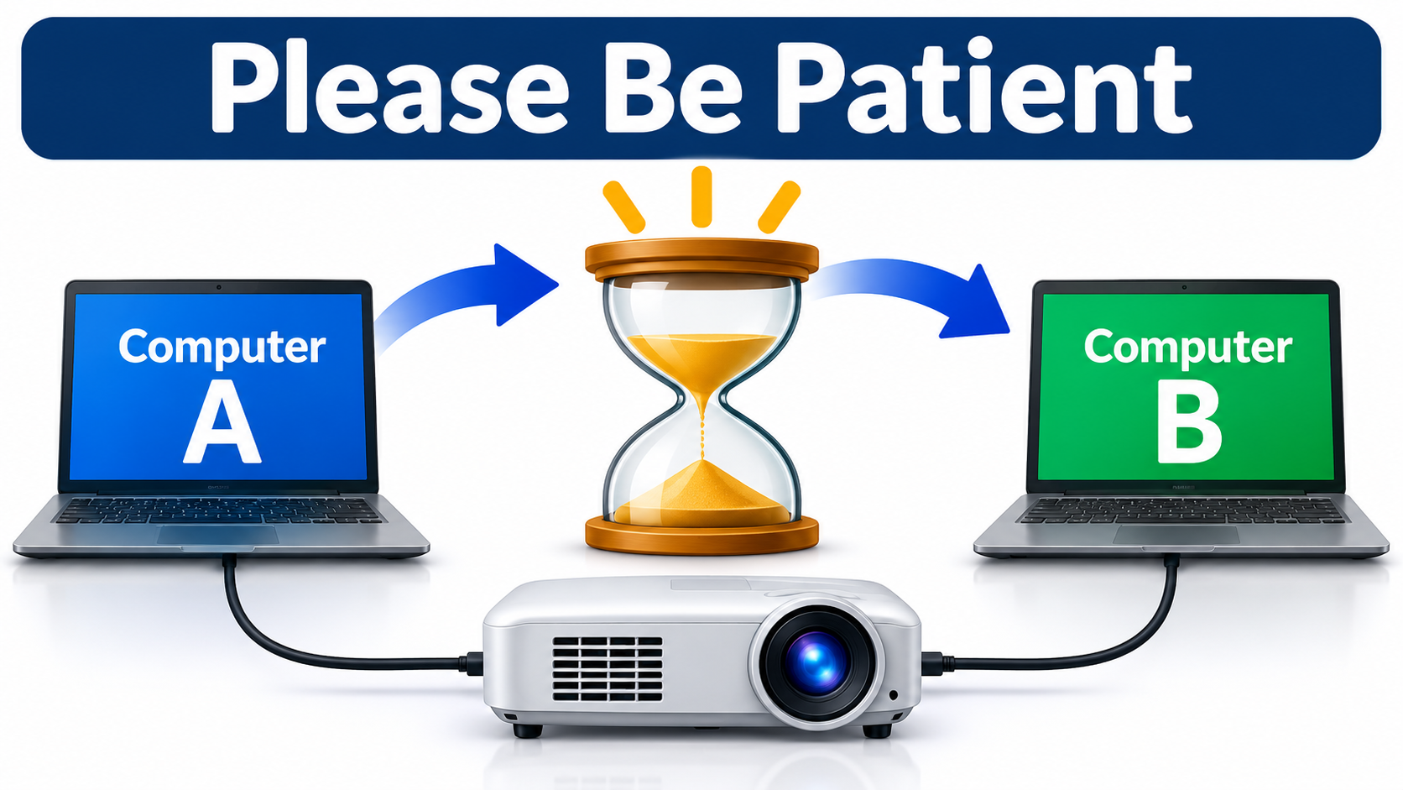
11. ClarkLinsey Use of LLM AIs
How administrative staff use AI to improve the CLV environment we share.
Notes:
Close the use section at home. The staff here already use these tools for ordinary administrative work, and the infographic on the screen is one result. Ask the room what they would hand to a model if it saved an hour a week. The answers set up the benefits and deficits pages that follow.

Slide 12
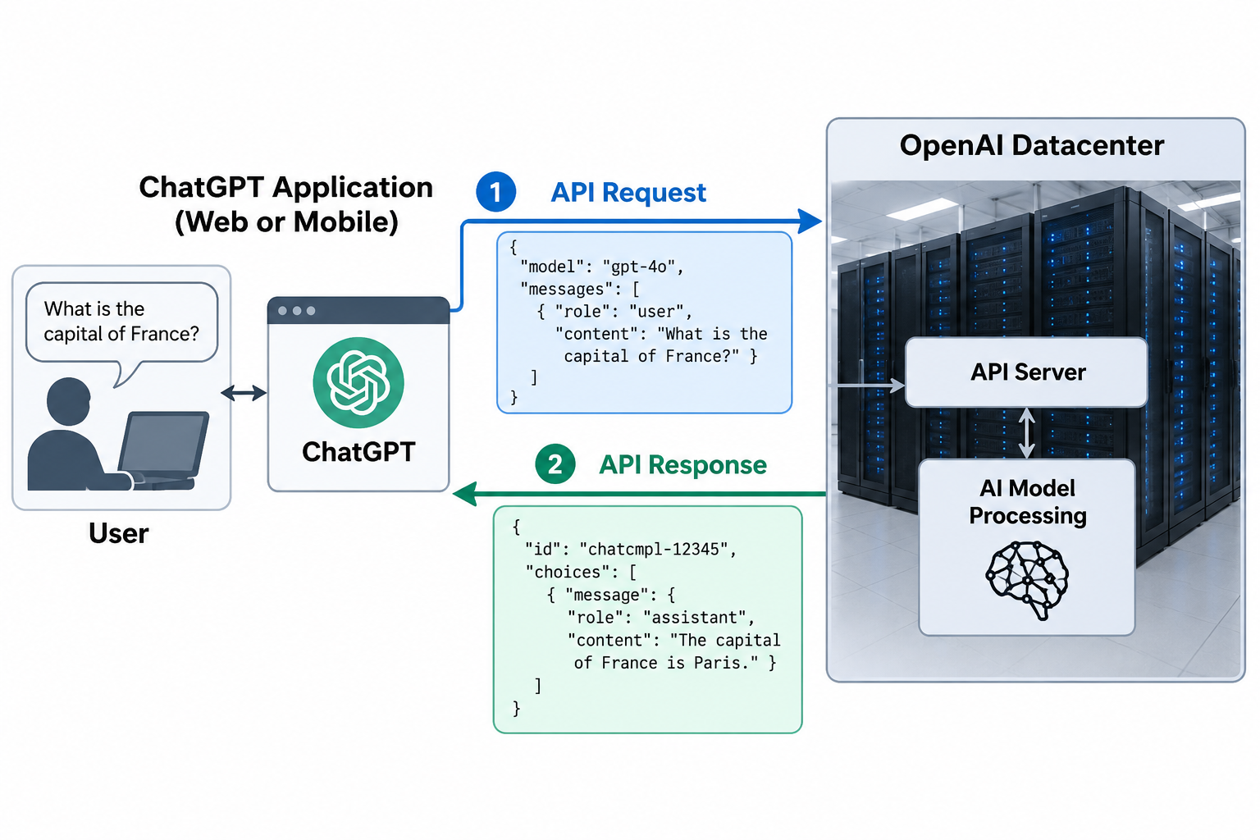
12. How Large Language Model AI Chat Bots Work
The question leaves your device. The answer comes back from a building you will never see.
Notes:
Walk the path once, left to right. The question leaves the browser, crosses the internet, reaches a server in a data center, and the reply comes back the same way. Nothing runs on the attendee's own machine. Say that ChatGPT drew this diagram itself when asked for a concept diagram, and that the Claude version looks nearly identical.

Slide 13
13. What the Bot’s Browser App Cannot Do
Web and mobile applications work under security limits:
  They cannot edit data on your computer.
  They can copy a file, change the copy, and send it to your downloads folder.
  To work on several files at once, put them in a zip file and attach it to the prompt.
Those limits protect you. They also explain the next two pages.
Chat Bots are effective for question and answer conversations.
They are awkward for creating multipage presentations and other multi-file work.
Notes:
This slide answers the question people ask after the demonstration: can it just fix my document? In a browser, no. The application runs inside a sandbox that cannot reach your files. Frame the limit as protection rather than as a shortcoming, then point forward: the command line interface removes the limit, and that is exactly why it deserves care.

Slide 14
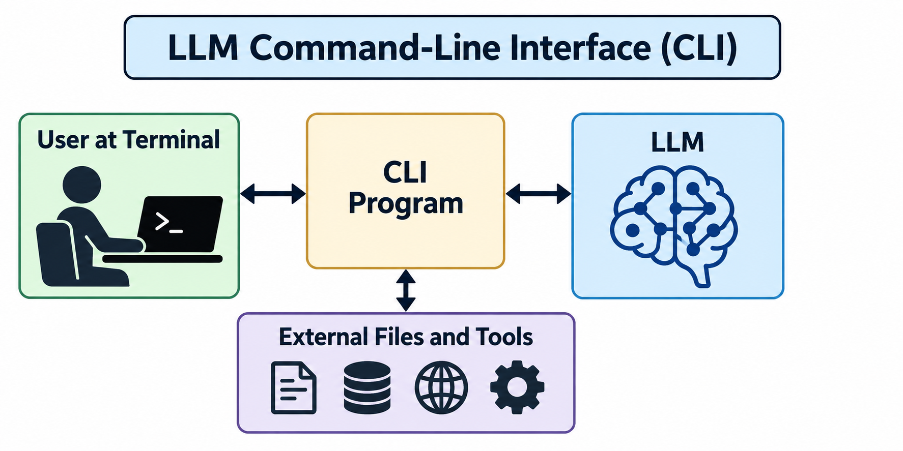
14. The Command Line Interface
A terminal window replaces the browser. The user downloads the CLI from OpenAI or Anthropic.
Notes:
Ignore everything except the four boxes down the middle. A terminal is a plain text window where you type commands rather than click. It replaces the browser from the previous slide, and the CLI application talks to the model on your behalf. Downloading it from OpenAI or Anthropic is a one-time step.

Slide 15
15. What the CLI Adds, and What It Risks
Unlike a browser, the CLI can read, edit, and delete files on your computer.
People use it to build presentations and to write or assist in writing books.
The old rule applies: garbage in => garbage out. The industry calls the result AI slop.
Assistance works when the person supplies the structure, the ideas, and the editing.
This presentation was built with a lot of assistance from the Claude Code CLI.
Notes:
Be candid here. The CLI is the tool that produced the pages the audience is looking at, and saying so earns the right to describe its failure mode. AI slop means fluent output that nobody shaped and nobody checked. The division of labor is the point: the person brings the argument and the judgment, the model brings speed.

Slide 16
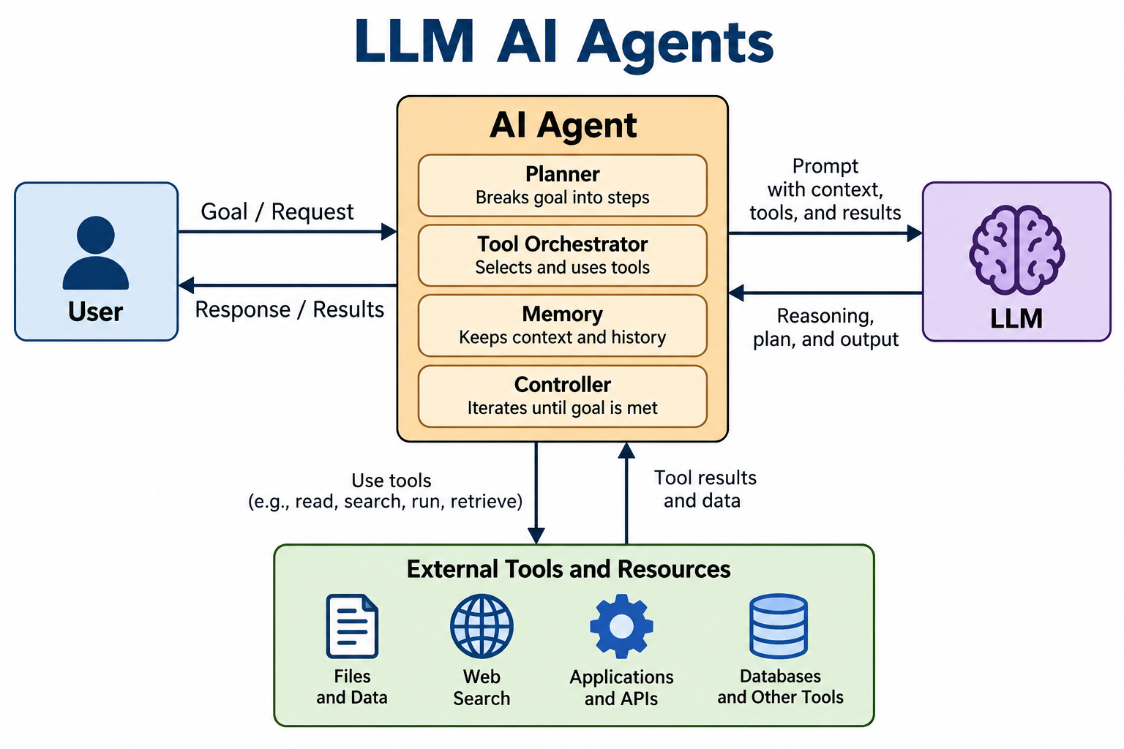
16. Autonomous AI Agents
An agent runs on its own from a starting prompt until it reaches a goal you set.
Notes:
Agents appear constantly in the news and almost nobody in the room will run one soon. Cover them anyway, because they drive both the benefits and the liabilities later in the talk. The loop on the screen repeats: the agent reads the goal, acts, checks the result, and goes again until it decides it is done.

Slide 17
17. Agents: The Good, the Bad, and the Dangerous
Good news
  When an agent runs well, a lot gets done without your attention.
Bad news
  A misdirected agent produces junk and deletes good content.
  Much of what it does rests on meaning it inferred from your request, so the error is hard to prevent.
  Developers test in a sandbox, meaning an isolated copy, and deploy only once it works.
Really bad news
  Bad actors run swarms of agents against banking security and infrastructure controls, and post misinformation at scale.
Notes:
The three-part structure is deliberate. Spend the least time on the good news, which the press already covers. The middle point is the honest one: the agent acts on what it inferred you meant, and that gap is where damage happens. End on the swarm problem, because it connects directly to the misinformation section later.

Slide 18
18. Compare Chat Bot, CLI, and Agent
Works well for question-answer conversations.
Awkward for handling multiple files.
Works well with user guided development of multi-file projects.
Runs autonomously on complex tasks.
Notes:
One slide to fix the three shapes in memory before the benefits and liabilities sections. Top row is what the room has already seen demonstrated. Middle row is the tool that produced these pages. Bottom row is the one they will read about rather than run. Say that the three differ in how much they can reach and how much supervision they need, in that order.

Slide 19
19. AI Benefits: Where the Gains Show Up
The source document (in Slide 6 References) sorts the gains into seven areas.
One pattern runs through all seven:
  The model supplies, at low cost and on demand, help that used to require a person's time.
  A tutor, a translator, a clerk, a first-draft writer.
Where that help was already scarce, the gain is largest.
Notes:
One sentence carries this whole section: the gain is largest where the help was already scarce. A reader in a country with enough teachers notices a convenience. A reader without notices something else. Keep that asymmetry in mind through the next two slides, because it returns inverted in the deficits section.

Slide 20
20. Seven Areas of Gain (1 of 2)
Education and knowledge access
  Tutoring at any hour reaches students where teachers are scarce, in hundreds of languages, at each learner's pace.
Healthcare
  Drafting and summarizing return clinician time to patients, and restate instructions in plain language.
Economic opportunity
  A solo operator gets marketing copy, bookkeeping, and customer answers that once required a hire.
Science and research
  Literature review and routine code move faster, and the model translates the jargon between fields.
Notes:
Four areas, one line each. Do not read the slide. Pick the one closest to the room, probably healthcare, and give an example: a discharge summary rewritten so a patient can act on it. The research point matters to this audience in particular, since the model translates vocabulary between disciplines that otherwise talk past each other.

Slide 21
21. Seven Areas of Gain (2 of 2)
Inclusion and accessibility
  People with disabilities read, write, and navigate with less friction. Legal basics, tax forms, and government paperwork reach people who cannot pay professional fees.
Public services and crisis response
  Agencies simplify public information, and responders summarize reports across languages while the situation moves.
Language and culture
  Communities document endangered languages, and creative work reaches readers in languages it was never published in.
What the gains depend on: access, accuracy safeguards, and deployment choices.
Notes:
End the section on the last line rather than the list. Every benefit here is potential, not guaranteed. Access means a connection, a device, and support for your language, and someone missing any of the three gets none of this. Accuracy safeguards mean a person checks the output, because a wrong answer arrives in the same confident wording as a right one. Deployment choices decide who gets the tool at all.

Slide 22
22. AI Liabilities: Where the Damage Lands
The companion document (in Slide 6 References) sorts the liabilities into eight areas.
One pattern runs through all eight:
  The same low cost that puts a tutor in everyone's hands puts a forger, a scammer, and a confident wrong answer there.
Scale cuts both ways.
The people who absorb the damage are rarely the people who chose to deploy the model.
Notes:
This slide mirrors the benefits opener on purpose, and the audience should feel the symmetry. The last line is the one to dwell on. The company deploying a model books the savings, while the patient, the job applicant, or the town hosting the data center absorbs the cost. Economists call that an externality. The question of who answers for it comes back at the end of the section.

Slide 23
23. Eight Areas of Liability (1 of 2)
Security and misuse
  Personalized phishing and fraud scale up, and mounting an attack demands less skill than it did.
Environmental and resource costs
  Training and answering both draw large amounts of electricity. Cooling consumes water, and the load strains local grids.
Misinformation and trust
  Fabricated statements arrive in confident wording. The industry calls them hallucinations. Trust in genuine material erodes, since anyone can now dismiss a real document as AI-generated.
Economic disruption
  Writing, support, translation, programming, and administration face job losses or wage pressure, unevenly distributed.
Notes:
Define hallucination once, here. The word sounds harmless and the behavior is not: nothing in the output marks the difference between a fabricated citation and a real one. On bias, make the institutional point rather than the individual one. A stereotype in a chat reply is irritating. The same stereotype inside a hiring screen changes a life.

Slide 24
24. Eight Areas of Liability (2 of 2)
Inequality and access
  The models serve the connected first and perform worse in lower-resource languages.
Bias and fairness
  Models restate the stereotypes in their training text, which matters when institutions use them for hiring, lending, or benefits.
Privacy and data rights
  Text typed into a prompt gets stored. Training used copyrighted and personal material without clear consent, and the courts have not settled ownership.
Human and social effects, governance and accountability
  Skills people stop exercising weaken. When a model causes harm, no one has settled who answers for it.
Safeguards, regulation, transparency, and oversight each cut these risks. How much depends on deployment.
Notes:
Privacy is the point most likely to change behavior in this room, so say it plainly: treat a prompt like a postcard. The environmental cost sets up the data center section that follows, so hand off to it here. Close on the qualified note the source document ends with, and resist the urge to sound either alarmed or reassured.

Slide 25
25. Data Centers: Power Is the Unit
Every answer a chatbot gives arrives from a building that holds racks of computers, the power to run them, and the cooling to carry away their heat.
Capacity gets measured in power, not in floor space, because power binds:
  A megawatt (MW) is one million watts.
  A 100 MW campus draws about what 80,000 American homes draw on average.
  A gigawatt (GW) is one thousand megawatts, roughly one large nuclear reactor.
Treat every percentage that follows as an estimate. Sources disagree, and construction outruns the tables.
Notes:
The unit matters more than any single number. A site holds as much computing as its electric supply and cooling can sustain, which is why operators talk in watts instead of square feet. Use the 80,000 homes comparison and pause there. Then warn that the percentages in the next slides are estimates that move faster than published tables.

Slide 26
26. Sixty Years, Ten Thousand Times the Power
Operators site these buildings for power, fibre, workforce, tax terms, and a cool climate.
Era | Dominant driver | Scale
1960s-1980s | Mainframe computing | 10-100 kW
1990s | Client/server and early web hosting | 100 kW to 1 MW
2000s | Dot-com boom, search, early SaaS | 1-10 MW per facility
2010s | Cloud, mobile, video streaming | 10-200 MW per campus
2020-2024 | Pandemic cloud migration, early AI | 100-500 MW per campus
2025+ | Large-scale AI training and inference | 500 MW to 1+ GW per campus
Notes:
Each era added a workload the previous buildings could not hold. Global capacity reached 60 to 70 GW by 2024, doubling about every four years, and analysts project more than 200 GW by 2030. Water follows power: a 100 MW facility can use 1 to 3 million gallons a day for cooling, which is what a town of 10,000 to 30,000 people uses.

Slide 27
27. Where the Buildings Stand
Operators follow power, fibre, workforce, political stability, tax terms, and cool air.
Region | Share | Key concentrations
United States | ~35% | Northern Virginia (Ashburn) is the largest market on earth; also Dallas, Silicon Valley, Chicago, Phoenix, Atlanta
European Union and UK | ~22% | Amsterdam, Frankfurt, Dublin, London, Paris; the Nordics add cold climate and renewable power
China | ~15% | Beijing, Shanghai, Shenzhen, Guangzhou; new capacity moves west to Guizhou and Inner Mongolia
India and Australia | ~7% | Mumbai, Chennai, Hyderabad, Pune grow fastest; Sydney and Melbourne serve the Pacific
Southeast Asia | ~6% | Singapore is the hub; land and power limits push growth to Johor Bahru, Jakarta, Bangkok
Rest of world | ~6% | UAE and Saudi Arabia invest in AI-scale campuses; also South Africa, Japan, South Korea
Canada and Mexico | ~4% | Toronto, Montreal (cheap hydro), Vancouver; Queretaro, Mexico City, Monterrey
Central and South America | ~3% | Brazil (Sao Paulo) dominates, with growth in Chile, Colombia, and Argentina
Russia | ~2% | Moscow dominates; law requires Russian user data to stay on Russian soil
Notes:
Two forces pull capacity away from the dominant clusters. The first is latency, the delay between a request and its reply: light in fibre costs about 1 millisecond of round trip per 100 kilometres, so a user in Mumbai served from Virginia waits 150 to 200 milliseconds before anything happens, which a person notices. The second is data sovereignty: rules in the European Union, India, Russia, and China require certain data to stay inside national borders, so operators build locally even where the economics favour one large site elsewhere. Shares approximate global installed IT capacity as of 2025.

Slide 28
28. What the Machines Actually Do
Approximate shares of global data center computing, 2024 and 2025.
Category | Share | What runs there
Enterprise and business IT | ~25% | Accounting, sales, email, internal applications
AI and machine learning | ~18% | Training models and answering queries; up from 10% in 2022
Video streaming | ~15% | Netflix, YouTube, TikTok: storage and format conversion
Social media | ~8% | Feed ranking, content storage, ad targeting
E-commerce and search | ~11% | Transactions, logistics, crawling, indexing
Financial services | ~5% | Trading, fraud detection, payments, reporting
Everything else | ~18% | Communications, gaming, science, government, health, security
Notes:
The headline correction is that AI is not what most of this machinery does. Enterprise computing still leads. The AI share is the one number that moves fast: near 10% in 2022, near 18% in 2025, and an ABI Research estimate of 38% for 2026. Whether that figure proves right matters less than its direction. Geography: the United States holds about 35% of capacity, the EU and UK about 22%, and China about 15%. The reassuring version for this audience: AI is the second largest consumer of data center capacity, not the first, and most of that is building models rather than answering questions. A dozen ChatGPT questions use far less than streaming one movie or making one Amazon purchase. Nobody needs to feel guilty about asking.

Slide 29
29. Economics: Neither Company Makes Money
Two companies dominate the chatbots in this presentation. Both grow revenue several times over each year, and both spend far more than they take in. Investors cover the gap.
Three terms carry the numbers:
  Revenue is what customers pay.
  Operating loss is revenue minus the cost of running the business.
  Net loss adds accounting charges that move no cash, so it can dwarf the operating loss.
In 2025 the two together reported about 18 billion dollars of revenue and about 29 billion of operating loss. For every dollar a customer paid, they spent roughly 2.60 dollars.
Notes:
Define the three terms before any figure appears, because the net loss numbers on the next two slides look absurd without them. Neither company publishes financial statements. These figures come from audited documents reporters obtained, verified by the Financial Times in June 2026 and reviewed by Reuters in September 2026. The 2.60 dollars is the number to leave in the room.

Slide 30
30. Financials: OpenAI, 2022 to 2025
A nonprofit with a billion dollars in pledges reached 13 billion in revenue ten years later.
Year | Revenue | Compute | Operating loss | Net loss
2022 | ~$28M | n/d | n/d | ~$0.54B
2023 | ~$1B est. | n/d | n/d | n/d
2024 | $3.7B | ~$7B est. | $8.78B | ~$5B
2025 | $13.07B | ~$17.2B | $20.92B | $38.53B
Notes:
Revenue grew 3.5 times between 2024 and 2025, and the operating loss grew 2.4 times alongside it. Compute is the reason: OpenAI paid Microsoft about 17.2 billion dollars in 2025, which exceeded the company's entire revenue. Roughly 30 billion of the 38.53 billion net loss is a one-time charge with no cash attached, tied to the move to a Public Benefit Corporation. The operating loss of 20.92 billion is the number that reflects running the business. A 40 billion dollar round arrived in 2025 and a 122 billion dollar round followed in March 2026.

Slide 31
31. Financials: Anthropic, 2022 to 2025
Started five years later, at a smaller scale, and shows the same pattern.
Year | Revenue | Compute | Operating loss | Net loss
2022 | ~$10M est. | n/d | n/d | n/d
2023 | ~$100M | n/d | n/d | n/d
2024 | $386M | ~$2.5B | $2.98B | $8.31B
2025 | $4.59B | $7.33B | $8.06B | $41.97B
Notes:
Same shape, smaller scale, five years later. Revenue multiplied about twelve times in one year, and the company still spent nearly three dollars for every dollar it earned. Compute came to 1.6 times revenue and 58 percent of operating expense. About 34 billion of the 41.97 billion net loss is a non-cash charge. Note who funds this: Amazon put in 8 billion across two years, Google roughly 1.8 billion, and Microsoft and Nvidia committed up to 15 billion. Money flows from the cloud providers to the model builders and much of it flows back as payment for computing.

Slide 32
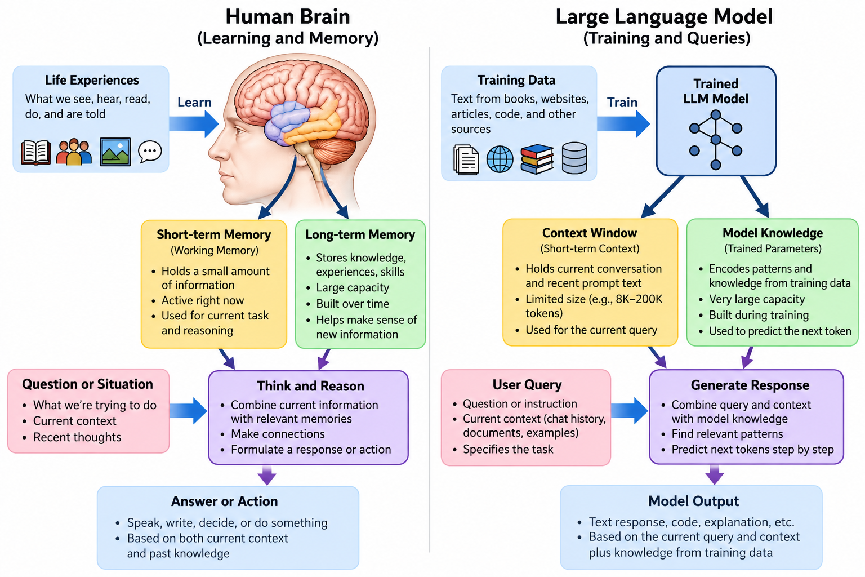
32. Human Brain and Large Language Model, Side by Side Analogy
The same path runs down both columns: learn, store, recall, answer.
Notes:
Walk the two columns in parallel. Life experience teaches a person; text teaches a model. Working memory holds the current task; the context window holds the current conversation. Long-term memory and trained parameters hold everything else. One difference in kind: training a brain takes a lifetime, while training a model is one enormously expensive process that must finish before anyone can use the result.

Slide 33
33. Significant Differences
The human brain writes parts of its short term memory into long term memory.
LLM models do not do that.
  Letting query context modify trained data would open the door to corrupting the training data with bad information, by accident or on purpose.
That corruption may happen with humans too. Perhaps that’s why we have cults and misinformation.
In an LLM Chat Bot conversation, all of the context travels with every request. The remote model stores nothing between requests.
Notes:
Two points land here. First, the model has no memory of you between sessions, which explains why the whole conversation gets resent every time and why privacy advice matters. Second, the model cannot learn from your conversation, and that is a design decision rather than a limitation: a model that learned from everyone talking to it could be poisoned by anyone talking to it. Close on the human parallel and let the room finish the thought.

Slide 34
34. Large Language Model AI - Take Aways
Chat Bots provide useful answers - just ask the questions
  Technology, health care, things to do
LLM AI Technologies have big benefits and even bigger liabilities
  Read AI articles and share
  Talk about AI over dinner
  Vote with purpose
Notes:
Land the hour on two sentences. The first is an invitation: the tool rewards anyone willing to type a question, and nothing in the morning required skill. The second keeps the balance honest, and the word bigger is deliberate - say why you chose it, then stop and take questions.

Slide 35
That’s All Folks!
Thanks for Coming
Notes:
Stop talking and take questions. Remind the room that every page, every source document, and every example prompt stays online, so nobody needed to write anything down.

